Slide 1

6.1 Memory
3
In previous chapters, we studied the components that memory is built from and the ways in which memory can be accessed by an ISA.
In this chapter, we will study types of memory and the effect of memory organization on system performance.

Slide 2
6.2 Classifying memory
3a
Two ways to classify memory
  By hardware - what it is made of
  By function - what it is used for

Slide 3
6.2 Two types of memory
3b
Two basic types of memory
  RAM - random access memory
  ROM - read-only memory
Both are random-access
  RAM can read and write
  ROM is read-only

Slide 4
6.2 Two types of memory
4
RAM - random access memory
  “Main memory”
  What is meant in computer specs and ads when they say “2GB of RAM”
  Volatile = loses value when power is turned off
ROM - read-only memory
  Non-volatile = maintains value even when powered off

Slide 5
6.2 Uses of ROM
4a
Uses of ROM
  Maintain critical information about the system, e.g., info necessary to boot
  Used in embedded systems such as toasters, toys and cars
    Embedded system = CPU is embedded in another device
  Used in calculators and printers (to store fonts)

Slide 6
6.2 Five types of ROM
4b
Five types of ROM
  Ordinary ROM - hardwired
  PROM = programmable ROM - can be programmed once. Then fuses are blown and program can’t be changed.
  EPROM - erasable PROM - can be erased and reprogrammed. Erasing requires a special tool that emits ultraviolet light. Must erase whole chip.

Slide 7
6.2 Five types of ROM
4c
Five types of ROM (continued)
  EEPROM - electrically erasable PROM - can be erased using an electrical field (no special tools required), and can be erased one byte at a time
  Flash memory - EEPROM that can be written and erased in blocks. Most people own multiple flash drives today. Although currently more expensive than hard disk, because of its lighter weight and resistance to being shaken, we are starting to see flash memory used in various types of portable computers.

Slide 8
6.2 Two types of RAM
4d
Two types of RAM
SRAM
  Made of circuits similar to the D flip-flop
  SRAM doesn’t need to be refreshed as long as power is maintained = “static”
DRAM
  Made of capacitors that slowly leak charge over time
  Must be refreshed every few milliseconds to prevent data loss = “dynamic”

Slide 9
6.2 Two types of RAM
5
SRAM
  SRAM is faster and doesn’t need to be refreshed
  But SRAM is much more expensive
Advantages of DRAM
  DRAM is cheaper due to its simple design
  DRAM is denser = can store more bits in the same amount of space (e.g., on a given chip)
  DRAM uses less power
  DRAM generates less heat

Slide 10
6.2 Two types of RAM
5a
Uses of RAM
  DRAM is often used for main memory
  ... and SRAM for cache (to be defined)
  Why? Using a small amount of the faster memory where it can really make a difference

Slide 11
6.3 Memory hierarchy
6
Generally speaking, faster memory is more expensive than slower memory.
To provide the best performance at the lowest cost, memory is organized in a hierarchical fashion.
A small amount of faster storage (cache) is located on the CPU. A much larger amount of the slower main memory is accessed through the data bus.
An even larger amount of (almost) permanent storage in the form of disk and tape drives is still further from the CPU.

Slide 12
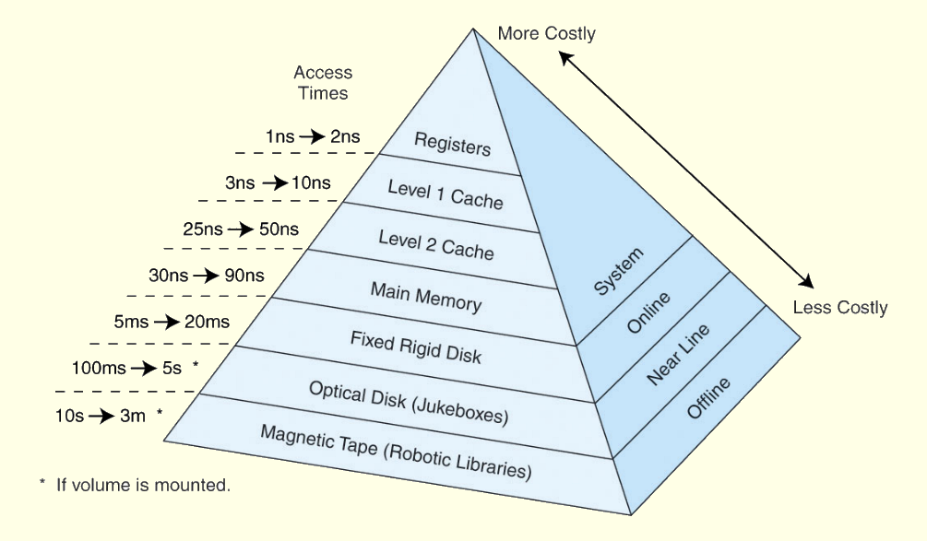
6.3 Memory hierarchy
7
This storage organization can be thought of as a pyramid:

